Slide 1

IT Ticket Analysis
Mr. Ayush Porwal
17/10/2024

Slide 2
About IT Ticket Analysis
Introduction:
The IT support ticket management system plays a crucial role in resolving technical issues within an organization. Effective management of IT tickets ensures timely resolution, satisfied employees, and efficient use of resources.
In this analysis, we focus on the performance of IT agents, the efficiency of ticket resolution, and overall employee satisfaction.
Objectives:
Identify high and low performers among IT agents based on resolution time and satisfaction ratings.
Assess ticket resolution efficiency to highlight areas needing improvement.
Analyze employee satisfaction to determine how well the IT support system meets user needs.
Provide data-driven recommendations for hiring, firing, or training decisions to enhance team performance.

Slide 3
Data Overview
Dataset Summary:
The dataset consists of two main sheets: Tickets and IT Agents.
Tickets Sheet: Contains information about IT support tickets, such As: Ticket ID, Date (Fecha), Employee ID, Agent ID
Request Category (e.g., Login Access, System, Software)
Issue Type (e.g., IT Error, IT Request), Severity, Priority
Resolution Time (in days), Satisfaction Rate (1-5 scale)
IT Agents Sheet: Contains agent information, such as:
Agent ID, Full Name, Email, Date of Birth (Year, Month, Day)
Key Data Points:
Total Tickets: 97,498
Total IT Agents: 50
Satisfaction Ratings range from 1 (low) to 5 (high)
Resolution Times vary based on the request category, issue type, and agent performance

Slide 4
Methodology
Data Cleaning:
Removed Duplicates: Got rid of any repeated records.
Handled Missing Values: Fixed missing information by either filling it in or deleting the affected rows.
Standardized Data: Made sure dates and categories were consistent
Analysis Techniques:
Basic Statistics: Calculated important numbers like average resolution time and ticket volume.
Trend Analysis: Looked at how ticket numbers changed over time using charts.
Comparison: Compared how well different agents performed.
Tools Used:
Used Excel features like:
Pivot Tables: To summarize and analyze data.
VLOOKUP: To find agent information based on their IDs.
Charts: To create visuals for easier understanding.

Slide 5
Overview of Dataset Attributes and Quality
Content:
Total Number of Attributes In Ticket Table is 10 and in IT Agent Table is 6
Missing Values Count is 0 (No missing or inconsistent values)
Key Takeaways:
The dataset is well-structured with no missing values, ensuring reliable analysis.
Understanding the attributes helps clarify the dataset's scope for further analysis.
IT Agent Table
Attribute | Description
Agent ID | Unique identifier for the agent.
Full Name | Agent's full name.
Email | Agent's email address.
Year of Birth | The year the agent was born.
Month of Birth | The month the agent was born.
Day of Birth | The day the agent was born.

Slide 6
Ticket Table
Attribute Name | Description
ID Ticket | Unique identifier for each ticket
Fecha | Date the ticket was created.
Employee ID | ID of the employee who submitted the ticket.
Agent ID | ID of the agent handling the ticket.
Request Category | Category of the request (e.g., Login Access).
Issue Type | Type of issue (e.g., IT Error).
Severity | Severity level of the issue.
Priority | Priority level for ticket resolution.
Resolution Time (Days) | Time taken to resolve the issue.
Satisfaction Rate | Employee satisfaction rating (1-5).
Severity Number | Numerical severity rating.

Slide 7
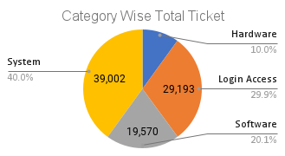
Ticket Volume and Category Distribution
Content:
Average Daily Ticket Volume is 106.67 Tickets Per Day
Distribution of Ticket Categories:
System: 39,002 (40.00%)
Login Access: 29,193 (29.94%)
Software: 19,570 (20.07%)
Hardware: 9,733 (9.98%)
Key Takeaways:
The System category dominates the ticket volume, indicating a primary focus area for support resources.
Understanding ticket distribution helps in identifying key areas for operational improvement and resource allocation.

Slide 8
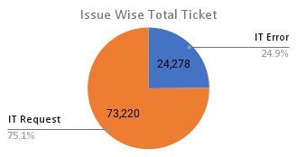
Agent Performance and Issue Resolution Insights
Content:
Agent Ticket Handling:
Average Resolution Time is 4.55 Days
Issue Type Count:
IT Error: 24,278
IT Request: 73,220
Key Takeaways:
Monitoring agent performance can help identify training needs and optimize resource distribution.
The average resolution time provides insights into the efficiency of the support process, indicating potential areas for improvement.

Slide 9
Investment Strategies for IT Support
Objective : Evaluate where investments should be allocated—hiring, training, or software enhancements.
Analysis Approach : Conduct a cost-benefit analysis using ticket resolution times and customer satisfaction metrics to inform strategic decisions.
Insights:
Hiring More IT Agents:
Benefits: Reduces workload on existing agents, potentially improving ticket resolution times.
Consideration: Requires ongoing salary and training expenses, impacting budget sustainability.
Improving Training Programs:
Benefits: Targeted training for agents with low satisfaction ratings can lead to enhanced performance and increased customer satisfaction.
Focus Areas: Address specific skills related to ticket resolution and customer interaction.
Upgrading Ticket Management Software:
Benefits: Enhances operational efficiency by streamlining ticket assignment and management processes.
Analysis: Review historical performance metrics before and after software implementation to measure improvements in resolution times and satisfaction rates.
Recommendation : Based on the analysis results, prioritize upgrading ticket management software for immediate efficiency gains, while concurrently investing in training programs for agents showing the most need for improvement. Hiring new agents can be considered later based on workload assessments and the success of the software upgrades.

Slide 10
Identifying Training Needs for IT Agents
Objective : Identify agents needing additional training based on performance metrics.
Analysis Approach : Focus on agents with the lowest satisfaction ratings and the longest resolution times to assess training needs.
Insights:
Agents Needing Training: Agents with the highest average resolution times and the lowest satisfaction scores include :
Agent 19: 5.00 days resolution time, 3.04 satisfaction score
Agent 6: 5.32 days resolution time, 3.59 satisfaction score
Agent 3: 5.38 days resolution time, 3.62 satisfaction score
Potential Reasons for Underperformance:
Lack of Experience: Newer agents may struggle with complex tickets or workflows.
Insufficient Training: Agents might not have received comprehensive training on specific ticket types or customer interaction skills.
Recommendation: Propose tailored training programs for specific agents identified as needing improvement. Focus areas could include:
Problem-Solving Skills: Enhance their ability to resolve tickets efficiently.
Customer Service Techniques: Improve interaction quality and customer satisfaction.
Technical Skills: Provide training on the specific tools and software used in ticket resolution.
Expected Outcome: : Improving agent performance metrics should lead to higher customer satisfaction and reduced resolution times.

Slide 11
Essential Metrics for IT Support Dashboard
Objective: Provide a comprehensive view of IT agent performance to identify areas for improvement and guide investment decisions.
Analysis Approach: Focus on agents with the lowest satisfaction ratings and the longest resolution times to assess training needs and performance improvement strategies.
Key Metrics to Include:
Average Resolution Time (Days)
Average Satisfaction Rate
Number of Tickets Handled
Breakdown by Year-Month, Issue Type, Severity, and Priority
Importance of Metrics:
Helps identify bottlenecks in the support process and areas where agents may need training.
Directly correlates with customer loyalty; improving this metric can enhance overall service reputation.
Useful for assessing individual agent workloads and potential resource allocation for hiring or training.
Provides a detailed understanding of performance patterns, guiding strategic decisions on where to invest resources and training.

Slide 12
Enhance Agent Training Programs
Recommendation : Implement a comprehensive training program focused on common ticket issues and customer service skills.
Data-Driven Reasoning:
Performance metrics show low satisfaction rates tied to specific ticket types, indicating a knowledge gap among agents.
Targeted training can help agents resolve issues faster and improve customer interactions.
Expected Impact:
Increased Customer Satisfaction: Improved agent skills will likely lead to higher satisfaction ratings from customers.
Reduced Resolution Times: Better-trained agents will handle tickets more efficiently, decreasing overall resolution times.
Implementation Steps:
Assess Training Needs: Identify agents needing support based on performance metrics.
Develop Training Sessions: Create focused training modules on identified gaps.
Monitor Effectiveness: Track performance improvements post-training.

Slide 13
Optimize Ticket Management Software
Recommendation: Upgrade to a more efficient ticket management system that offers advanced features such as automated ticket assignment and performance analytics.
Data-Driven Reasoning:
Current software is limiting in terms of tracking and reporting, causing delays in ticket resolution and performance evaluations.
Research shows that organizations with advanced management systems experience a 25% increase in operational efficiency.
Expected Impact:
Improved Agent Productivity: Automation of routine tasks will allow agents to focus on complex issues, enhancing overall productivity.
Better Insights for Management: Enhanced analytics will facilitate better tracking of performance metrics, supporting strategic decision-making.
Implementation Steps:
Research and Select Software: Evaluate options for a ticket management system that fits organizational needs.
Train Staff: Provide training for agents to maximize the benefits of the new system.
Monitor Performance: Regularly assess the system’s impact on ticket resolution and agent efficiency.

Slide 14
Expand Support Hours
Recommendation: Introduce extended support hours to cater to customer needs and improve accessibility.
Data-Driven Reasoning:
Survey results indicate a significant number of customers prefer accessing support outside regular business hours, particularly during peak usage times.
Expanding support hours aligns with industry trends where 24/7 support is becoming a standard expectation.
Expected Impact:
Increased Market Share : By offering extended support hours, the organization can attract new customers who require assistance during off-peak hours, thereby increasing market presence.
Enhanced Customer Loyalty: Improved accessibility is likely to lead to higher customer loyalty and encourage repeat business, as customers appreciate the availability of support when they need it most.
Implementation Steps:
Assess Staffing Needs: Determine the additional staffing required to cover extended hours effectively.
Communicate Changes: Inform customers about the new support hours through marketing and direct communication channels.
Monitor Feedback: Continuously gather customer feedback on the effectiveness of extended support hours to make further improvements.

Slide 15
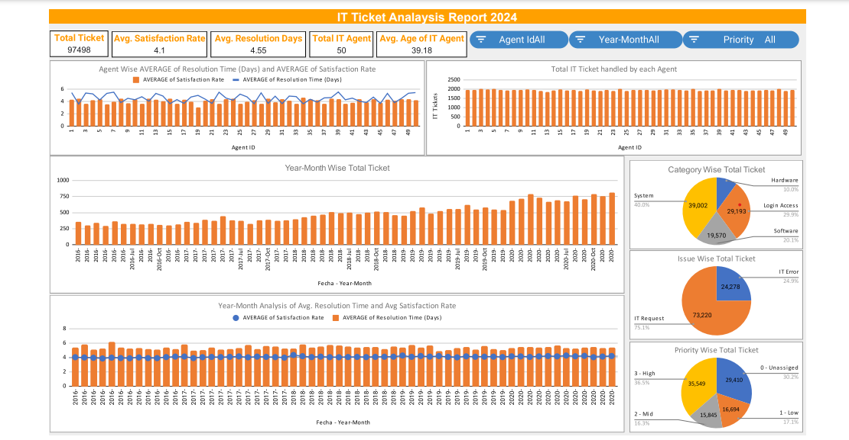
dashboard ON Google Sheet

Slide 16
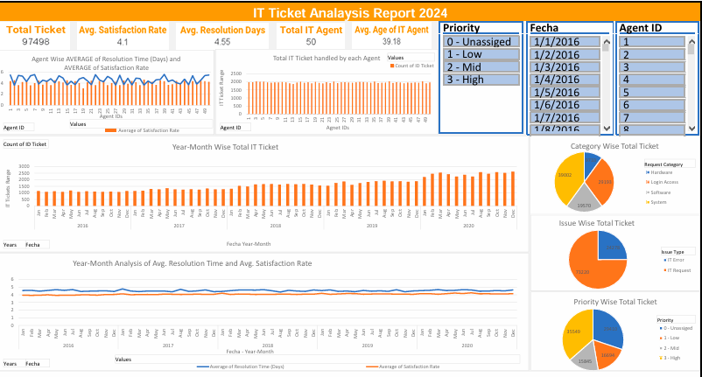
dashboard ON MICROSOFT EXECL 2013

Slide 17
Conclusion
Summary of Key Findings:
Customer Satisfaction Challenges: Identified specific areas where customer satisfaction is lacking, particularly related to ticket resolution times and agent knowledge gaps.
Market Opportunities: Highlighted potential new markets for expansion based on customer preference data and market saturation analysis.
Operational Inefficiencies: Noted inefficiencies in current ticket management processes that hinder performance.
Recap of Recommendations:
Enhance Agent Training Programs: Equip agents with necessary skills to improve customer interactions and resolution times.
Optimize Ticket Management Software: Upgrade to advanced software to streamline operations and improve data insights.
Expand Support Hours: Offer extended support to meet customer needs and improve accessibility.
Implications: Implementing these recommendations is expected to lead to increased customer satisfaction, enhanced operational efficiency, and expanded market share.

Slide 18
Acknowledgements and References
Acknowledgements:
I would like to express my gratitude to everyone who provided support throughout this project.
A special thanks to the online resources and communities that offered valuable insights and data.
I would also like to thank Newton School for their guidance and resources that significantly contributed to my understanding and execution of this project.
References:
Stack Overflow. (2023). Retrieved from https://stackoverflow.com
Cool article to do effective storytelling - https://www.analyticsvidhya.com/blog/2021/09/how-to-create-stunning-and-interactive-dashboards-in-excel/
How to do cool presentations - https://plumsolutions.com.au/five-rules-for-building-impressive-excel-dashboards/
YouTube Tutorials on Data Analysis. (2023). Retrieved from YouTube
preppindata to see sample dashboard https://www.preppindata.com/data-curious/it-support-ticket-analysis

